Slide 1
Impact of Car Features On Price And Profitability
By SONALI GUPTA

Slide 2
Project Description
As the automotive industry has been rapidly evolving over the past few decades, it has become more important than ever to understand the factors that drive consumer demand for cars.
So, we are going to look for the ways on how can a car manufacturer can optimize pricing and product development decisions to maximize profitability while meeting consumer demand?
This project involves analyzing the relationship between a car's features, market category, and pricing to identify the features and categories which are most popular and profitable for the manufacturer.
By using data analysis techniques such as regression analysis and market segmentation, the manufacturer could develop a pricing strategy that balances consumer demand with profitability.

Slide 3
Dataset Description
The dataset contains information on over 11,000 car models and their specifications, including details on the car's make, model, year, fuel type, engine power, transmission, wheels, number of doors, market category, size, style, estimated miles per gallon, popularity, and manufacturer's suggested retail price (MSRP).
Here is the brief overview of the given raw dataset:
• Number of observations or rows: 11,915
• Number of variables or columns: 16
• File type: CSV (Comma Separated Values)
The given dataset also contains some blank values and duplicates too, so we are going to clean them first so that our analysis will not be skewed.

Slide 4
After cleaning the given dataset by removing blanks, converting data types and removing duplicates, I have been left with:
• Number of rows: 11098
• Number of columns: 16
Although, the given dataset also contains N/A and unknown as values for few columns which will be filtered to get a comprehensive picture of the data.
This dataset could be useful for a variety of data analysis tasks, such as:
• Exploring trends in car features and pricing over time.
• Comparing the fuel efficiency of different types of cars
• Investigating the relationship between a car's features and its popularity

Slide 5

Tech-Stack Used
To complete this project, I am using MS Excel 2021 as it is an excellent analyzing and visualizing tool to analyze small size datasets.
Also, I will be using MS Power Point and MS Word to form a report.

Slide 6
Approach
After cleaning the given dataset, regression analysis and market segmentation are the two data analysis techniques that I will be using to help the manufacturer to develop a pricing strategy that balances consumer demand with profitability along with an interactive dashboard built in Excel.
Through regression analysis, we can determine the which car feature has the strongest relationship with the car pricing. This will allow manufacturers to identify key factors influencing a car’s price.
Also, through market segmentation, we can categorize customers into distinct groups based on popularity. With a clear understanding of the different customer segments, car manufacturers can customize their products and features to appeal to each group along with optimizing the pricing of the car.

Slide 7
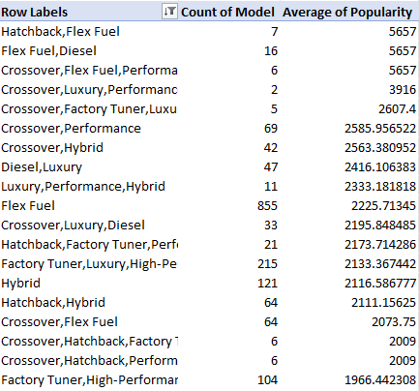
1. How does the popularity of a car model vary across different market categories?
• A: Create a pivot table that shows the number of car models in each market category and their corresponding popularity scores.
The above pivot table is showing the number of car models (excluding N/A) in each market category (the above screenshot is showing few categories. The rest of the values are available in excel sheet) and their corresponding popularity scores.

Slide 8
• B: Create a combo chart that visualizes the relationship between market category and popularity.
Insight Gained
After the analysis, it has been found that the crossover market category has the highest number of car models. Also, Hatchback, Flex Fuel and Crossover, Flex Fuel, Performance are the market categories that has the highest average popularity among other market categories.

Slide 9

2. What is the relationship between a car's engine power and its price?
I have also used CORREL function in excel to calculate the correlation coefficient between car’s engine power and its price. The correlation coefficient between the two is 0.658983, which means that a strong positive correlation exists between the two variables since the value is close to +1.

Slide 10
• Task 2: Create a scatter chart that plots engine power on the x-axis and price on the y-axis with a trendline.
Insight Gained
The above scatter plot is showing that car’s price is directly related to car’s engine power. It means if a customer desires a car with higher horsepower, then they have to pay more for their vehicle as price of the car rises along with the engine’s horsepower.

Slide 11
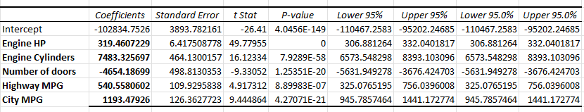
3. Which car features are most important in determining a car's price?
• Task 3: Use regression analysis to identify the variables that have the strongest relationship with a car's price. Then create a bar chart that shows the coefficient values for each variable to visualize their relative importance.
Regression analysis is a statistical technique used to model the relationship between a dependent variable and one or more independent variables where both variables are numerical in nature which we are going to perform using Analysis toolPak.

Slide 12
Graphical Representation
Insight Gained
As from the above bar chart, it is clear that engine cylinders variable has the strongest relationship with car’s price. It means that number of cylinders in the car’ engine tend to be associated with higher car prices. Also, as the coefficient for engine cylinder variable is highly positive, it suggests that on average, an increase in number of cylinders in a car’s engine is associated with an increase in the car price.

Slide 13
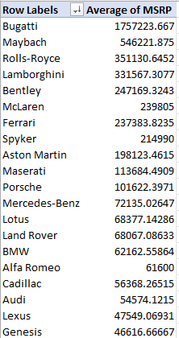
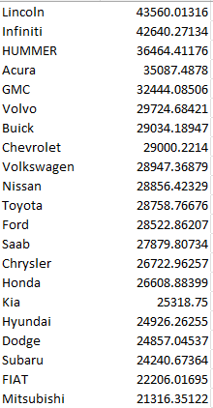
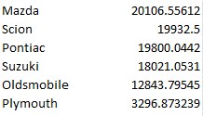
4. How does the average price of a car vary across different manufacturers?
• A: Create a pivot table that shows the average price of cars for each manufacturer.

Slide 14
• B: Create a bar chart or a horizontal stacked bar chart that visualizes the relationship between manufacturer and average price.
Insight Gained
After the analysis, it has been found that the Bugatti is the brand which has the highest car’s price.

Slide 15
5. What is the relationship between fuel efficiency and the number of cylinders in a car's engine?
• A: Create a scatter plot with the number of cylinders on the x-axis and highway MPG on the y-axis. Then create a trendline on the scatter plot to visually estimate the slope of the relationship and assess its significance.

Slide 16
• B: Calculate the correlation coefficient between the number of cylinders and highway MPG to quantify the strength and direction of the relationship.
To calculate the correlation coefficient between number of cylinders and highway MPG, I have used CORREL function in excel.
Now, as the correlation coefficient between number of cylinders and highway MPG is negative, then it means that a moderate negative correlation exists between the two.
Insight Gained
After the analysis, it has been found that a moderate negative correlation exists between the number of cylinders and highway MPG. This means that when the number of cylinders increases, the highway MPG tends to decrease. In other words, cars with more cylinders might be less fuel-efficient on the highway.

Slide 17
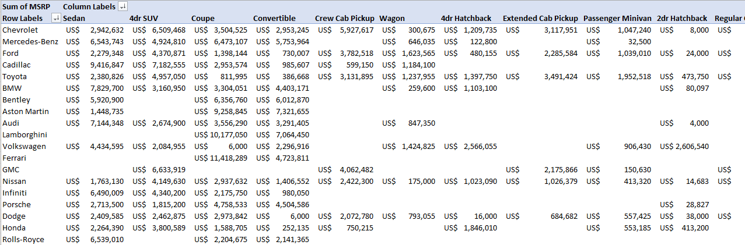
Tasks For Dashboard Building
Task 1: How does the distribution of car prices vary by brand and body style?
Below is the pivot table showing the distribution of car prices varying by brand and body style:
(The complete pivot table is present in project’s excel sheet)

Slide 18
Graphical Representation
The above chart is showing the distribution of car prices by brand and body style.
Insight Gained
After the analysis, it has been found that Chevrolet brand has the maximum MSRP in terms of brand and body style.

Slide 19
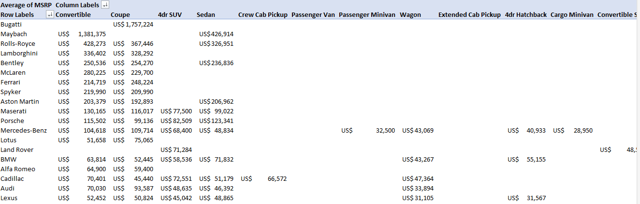
Task 2: Which car brands have the highest and lowest average MSRPs, and how does this vary by body style?
Below is the pivot table showing the average MSRP’s for each brand and body style combo:
(The complete pivot table is present in project’s excel sheet)

Slide 20
Graphical Representation
Insight Gained
After the analysis, it has been found that Bugatti has the highest and Plymouth has the lowest average MSRP’s.

Slide 21
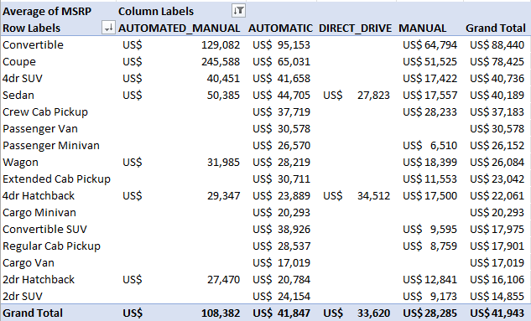
Task 3: How do the different feature such as transmission type affect the MSRP, and how does this vary by body style?
Below is the pivot table showing the average MSRP for each combination of transmission type and body style:
Data for Unknown transmission type has been filtered out in the above pivot table.

Slide 22
Graphical Representation
Insight Gained
After the analysis, it has been found that automated_manual transmission type and coupe body style is more popular among all others. Also, according to the pivot table the combination of automated_manual and convertible body style has the highest average MSRP among all others. This means that people prefer the cars which are automatic and manual too and also has a convertible or coupe body style.

Slide 23
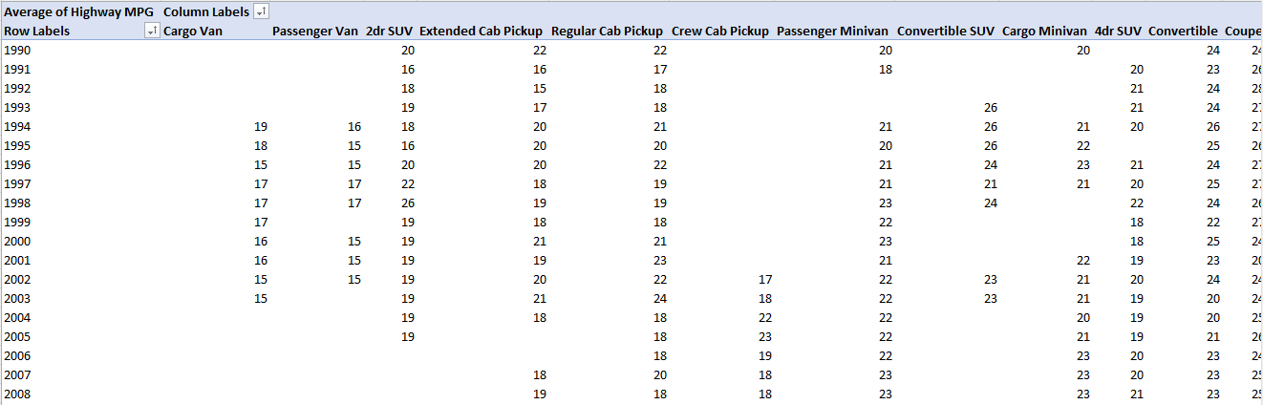
Task 4: How does the fuel efficiency of cars vary across different body styles and model years?
Below is the pivot table showing the avg. MPG for each combination of body style and model year:
(the complete pivot table is available in project’s excel sheet)

Slide 24
Graphical Representation
Insight Gained
After the analysis, it has been found that fuel efficiency of the cars has increased over the years for different body styles.

Slide 25
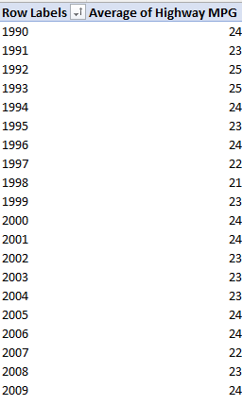
Pivot Table for Overall fuel efficiency over time
(the complete pivot table is available in project’s excel sheet)

Slide 26
Graphical Representation
Insight Gained
After the analysis, it has been found that fuel efficiency of the cars has increased over the years.

Slide 27
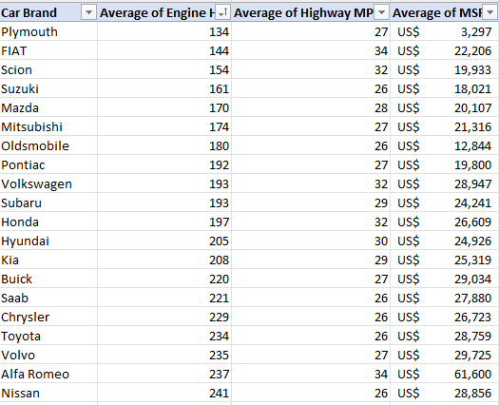
Task 5: How does the car's horsepower, MPG, and price vary across different Brands?
Data:
(the rest of the values are available in project’s excel sheet)

Slide 28
Graphical Representation
Insight Gained
After the analysis, it has been found that if the customer wants a car with high engine horsepower then they have to pay more and compromise with the mileage and if the customer wants the car with more mileage then they have to compromise with the car’s horsepower.

Slide 29
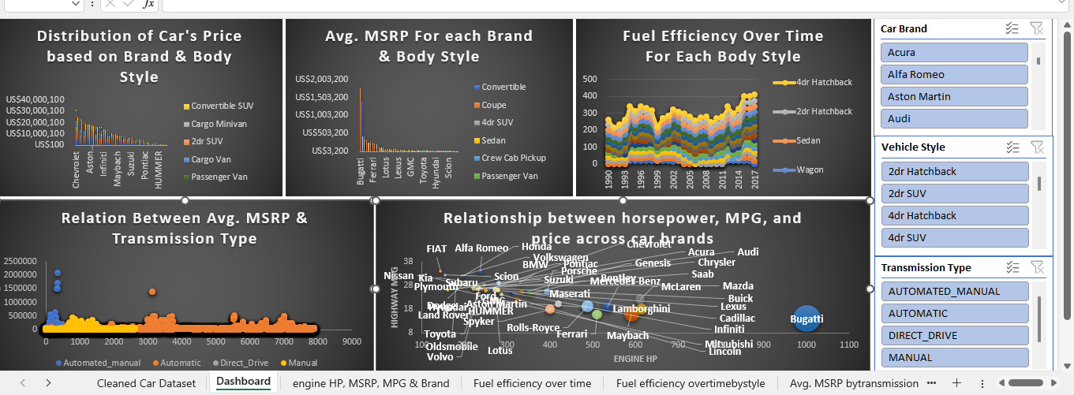
Interactive Dashboard’s Screenshot:

Slide 30
Insights
1) Crossover has the highest number of car models in the market. Also, Hatchback, Flex Fuel and Crossover, Flex Fuel, Performance are the most popular market categories among consumers.
2) After performing regression analysis, it has been found that number of cylinders in a car’s engine has the highest impact on a car’s price.
3) Cars with more cylinders might be less fuel-efficient on the highway.
4) Chevrolet brand has the maximum MSRP in terms of brand.
5) People mostly prefer cars that are automatic and manual too.
6) Coupe and convertible are the most preferred body style.

Slide 31
Result
1) As increase in the number of cylinders in a car’s engine adversely affects its fuel-efficiency of a car, so in future the company should produce car’s whose fuel efficiency is not compromised by increase in number of cylinders and its cost too.
2) As people prefers convertible vehicles that are automatic and manual too now, then maybe the demand for these types of vehicles will be very high.
3) As Hatchback, Flex Fuel and Crossover, Flex Fuel, Performance are the most popular market categories, so, by increasing the car’s production that belongs to these market categories will be beneficial for the company in future.
4) As car’s horsepower has direct impact on car’s price then it will be difficult for the people of low budget to buy car’s that have high horsepower.
5) As cars of Bugatti brand are expensive, so maybe increasing the production of other brands might be beneficial for the company in future.

Slide 32
Project Links:
Google Drive Link For The Project
Project’s Excel Sheet Link

Slide 33
THANK YOU

